Slide 2
Texas McCombs Investment Advisers LLC
Information Session

Slide 3
Texas McCombs Investment Advisers LLC

Slide 4
Agenda
Fund Manager Experience
4
Background and Structure
8
Application Process
14
Frequently Asked Questions
17

Slide 5
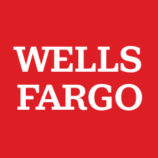
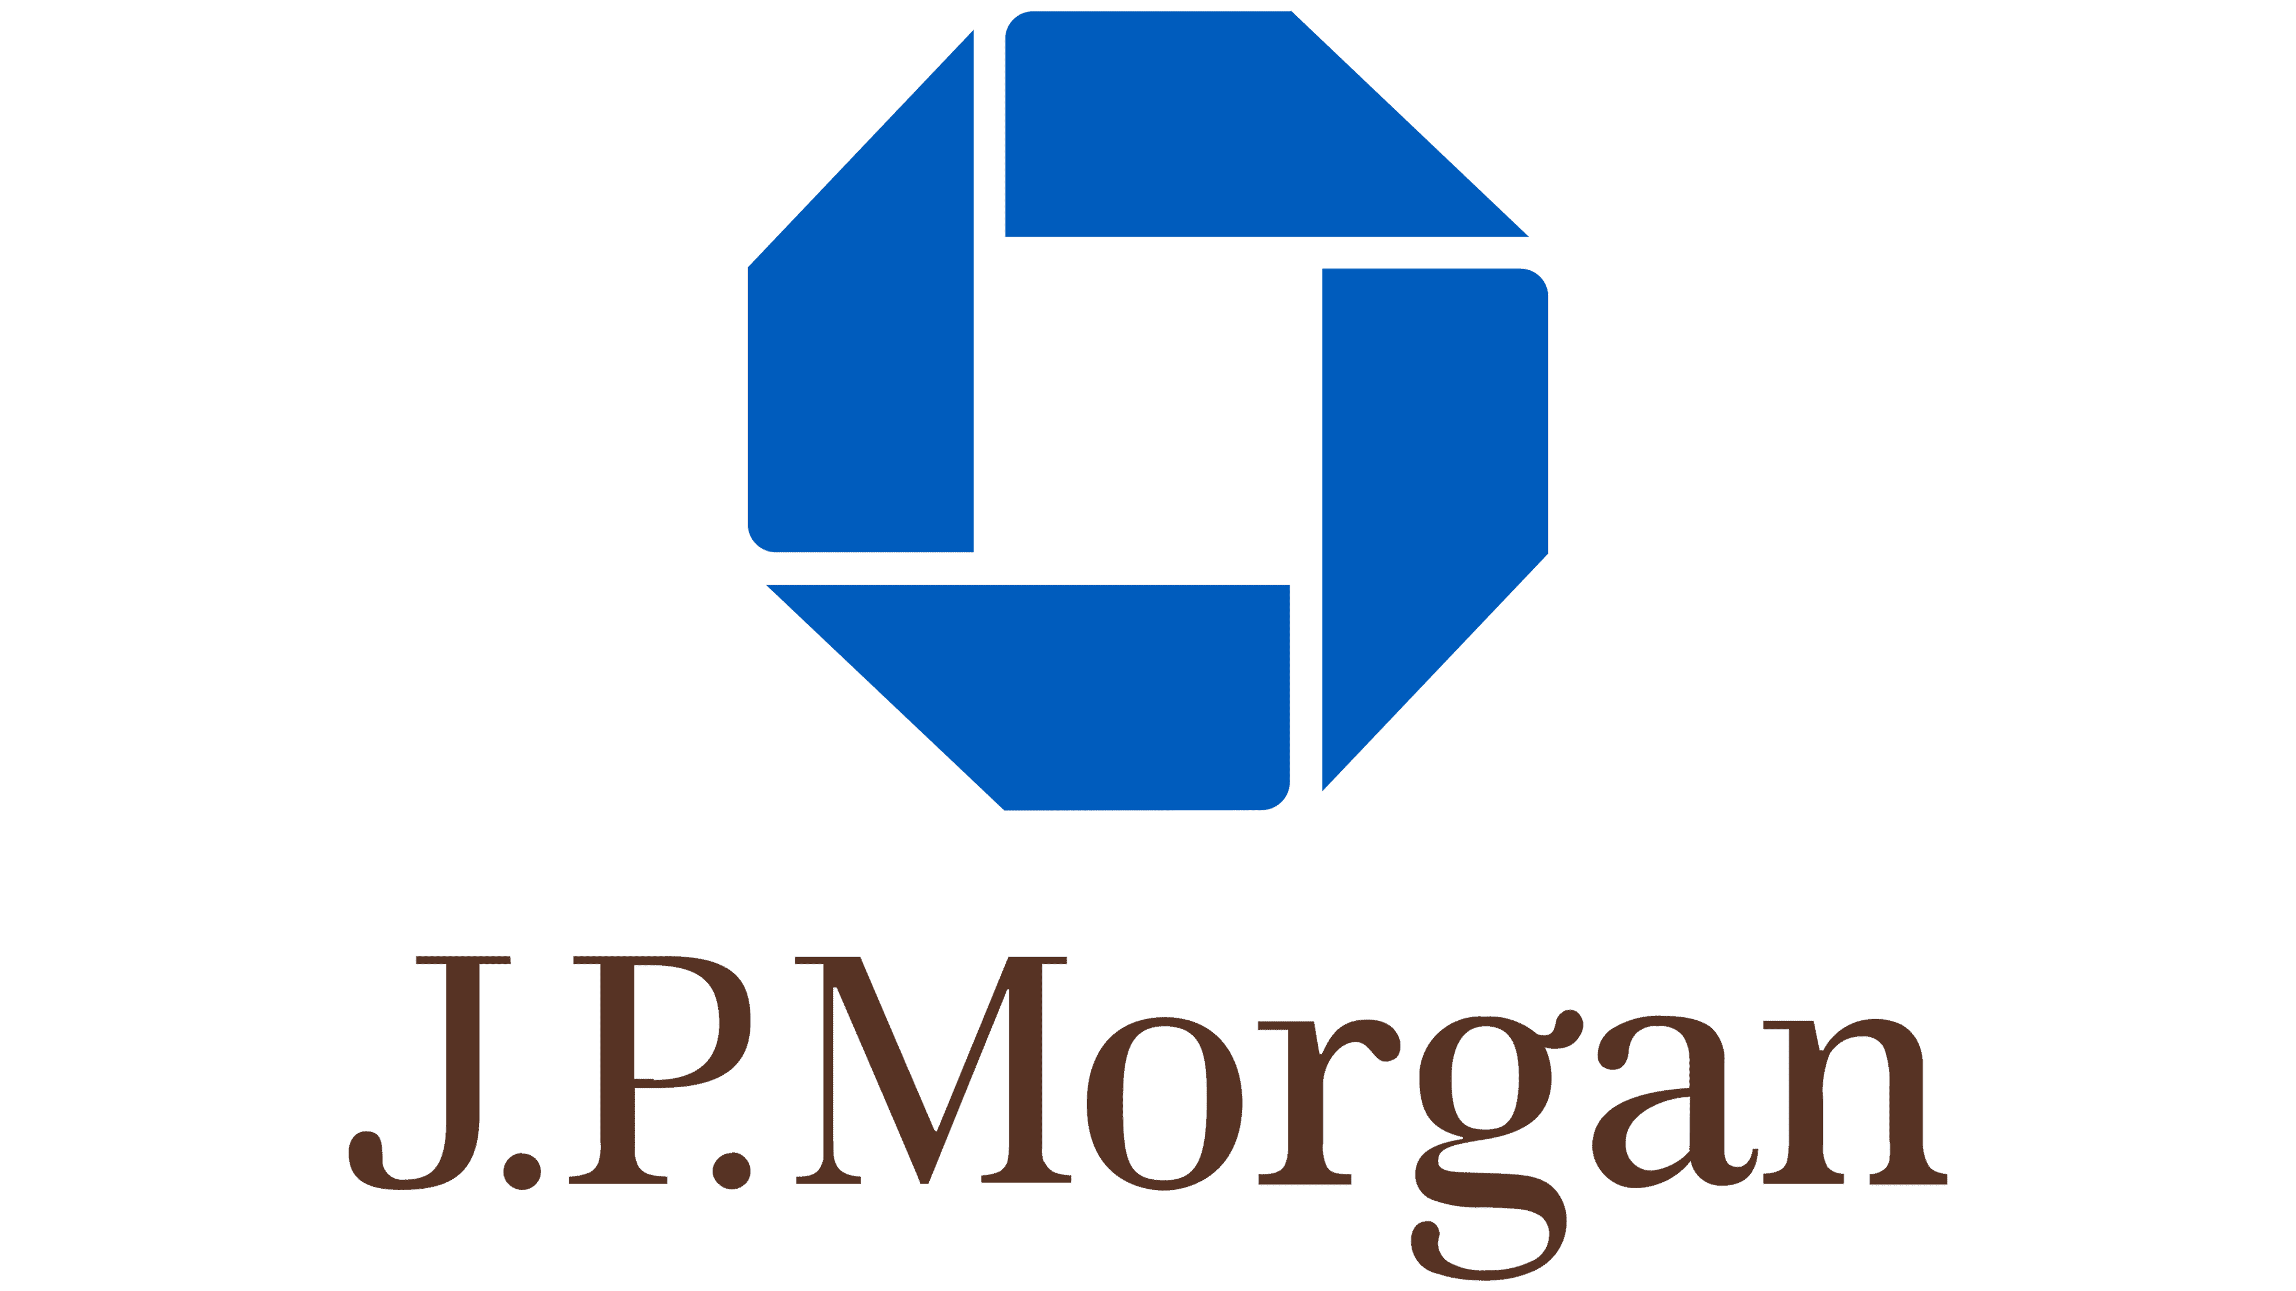
Student Fund Managers
What You Will Gain as a Fund Manager
Learn Asset Management and Apply that Knowledge in our $20MM Sandbox
Professional Development
Experience
Conducting Due Diligence Research
Performing Risk Reward Analysis
Managing and Allocating a Portfolio
Fund Speaker Series
Building Frameworks to Approach a Range of Investing Scenarios
Mentorship from Industry Investors
Generating and Pitching Ideas
Networking
Wealth Management
Goldman Sachs
JP Morgan
Dimensional
PIMCO
UTIMCO
TRS
Invesco
Wells Fargo
Family Offices
Private Equity
Hedge Funds
Impact Investing
Market Making
Public Speaking and Presentation Skills
Mutual Funds
480+ Fund Alumni
Access to the TMIA Trading room
Utilizing Database Tools (Bloomberg Terminal, Cap IQ, FactSet)
* Hoping to add more industries / positions/ type of work that the speakers we have had to this box
* Hoping to add a list of distinguished firms / companies that we visited or that alumni currently works at in this box

Slide 6
Student Fund Managers
What to Expect as a Fund Manager
Activity | Timeline
Portfolio Management | January – December 2025
Fellowship Responsibilities and Duties | 4 – 5 Hours Weekly Commitment
Investment Fund Class | Spring & Fall Semesters 2025 (3 Hour Credit Each)
Complete Required Courses | Investment Theory and Practice Spring 2025 (3 Hour Credit) Valuation Fall 2024 or Spring 2025 (2 Hour Credit)
Houston Trek | December 2024 15th – 16th (1.5 Days)
Boot Camp Finance Training | January 2025 8th – 10th (2 – 3 Days)
Present at Advisory Meeting | End of Spring & Fall Semesters

Slide 7
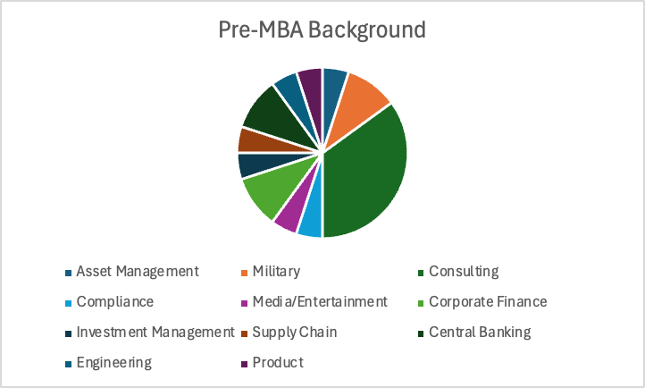
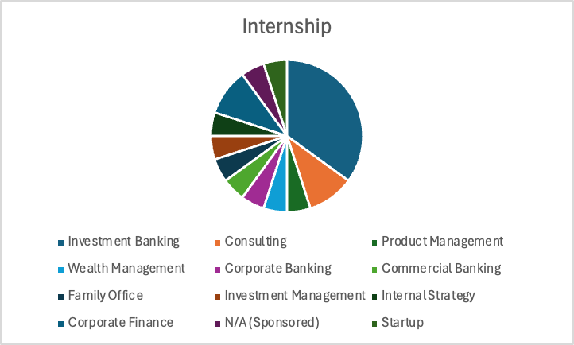
Student Backgrounds & Internships
Diverse pre-MBA background amongst current students
Majority coming from non-finance background
Discuss
Student Fund Managers
Majority pursuing finance or finance-adjacent industry
Again, diverse set of outcomes for our managers

Slide 8
Agenda
Fund Manager Experience
4
Background and Structure
8
Application Process
14
Frequently Asked Questions
17

Slide 9
Overview
Background and Structure
First legally constituted, private investment company managed by students
Founded in December 1994
Provide our MBA students with professional money management experience
Create value for our clients (UTIMCO and McCombs School of Business Foundation)
Consistent with these objectives, the Fund draws on the knowledge of a highly educated and experienced pool of faculty, professionals, and other organizations to deliver an unparalleled learning experience for a select group of well-qualified students.

Slide 10
Overview
Background and Structure
Texas McCombs Investment Advisers
Total AUM of over $20M*
Longhorn Fund
Actively managed
U.S. Equities
Long-only
Benchmarked to S&P500
Endowment Fund
Strategic asset allocation Target risk/return goal
Mostly in ETFs
*As of June, 2024

Slide 11
Overview
Team Roles Within Each Sector
Each student maintain two roles to help run the portfolios
Operations
Roles designed to support the overall business
PM Longhorn Fund
PM Endowment Fund
Business Development
Flex Roles
Report performance to investors/client
Ensure compliance with mandates
Execute trades and monitor price targets
Maintain databases and brokerage accounts
Research Analyst
Longhorn Fund
Consumer Discretionary & Staples
Energy
Healthcare & Finance
Technology and Communications
Develop new strategies and mechanics for the Fund
Perform Due Diligence
Analyze current market trend
Identify opportunities and new ideas to include into the Fund
Research Analyst Roles
Ops
Notes:
Risk Management

Slide 12
Overview
Background and Structure
The fund is split into sector teams, each seeking to answer the question:
What is the market not pricing in?
Consumer
Discretionary
& Staples
Energy Industrials Materials Utilities
Technology Communications
Healthcare
Finance

Slide 13
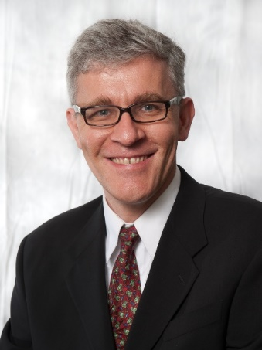
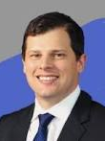
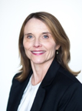
Faculty Mentors & Student Mentors
SECTOR COVERAGE
Clemens Sialm
Director, AIM Investment Center
Joshua Kocher
CEO, Texas McCombs Investment Advisers
Kelly Kamm
VP, Texas McCombs Investment Advisers
Student mentors from the 2025 fund manager class will guide and support the 2026 cohort, ensuring effective knowledge transfer, skill development, and a smooth transition throughout the semester.

Slide 14
Agenda
Fund Manager Experience
4
Background and Structure
8
Application Process
14
Frequently Asked Questions
17

Slide 15
Recruiting Process
Application and Recruiting Process
Level I
Submit the Application
Application will be made available on the Fund’s website at https://www.mccombs.utexas.edu/Centers/AIM/TMIA
Level II
1st Round of Interviews
25-minute interview with current members of the fund
Deadline: Saturday, September 14th at 11:59 PM
Please contact Christian Enciso, Schuyler Hedberg, Shubham Aggarwal, Matt Jacobs, Joshua Kocher, Kelly Kamm, or Clemens Sialm if you have any questions
Interviews held from September 23rd through September 26th
Mixture of behavioral, technical, and stock pitch questions
Class of 2026 Announcement Mid-October!

Slide 16
Agenda
Fund Manager Experience
4
Background and Structure
8
Application Process
14
Frequently Asked Questions
17

Slide 17
Frequently Asked Questions
FAQs
Q: What is the Fund looking for?
A: The Fund is looking for a diverse group of students with a genuine interest in financial markets and investing. We need people who are eager to work hard and are academically curious.
Q: Do I need a finance background to be on the Fund?
A: No, the Fund considers all candidates and has traditionally had many managers without prior finance work experience.
Q: What kind of internships and full-time jobs do Fund Managers obtain?
A: Fund Managers commonly take jobs in Investment Management (Mutual Funds, Hedge Funds, Pension Funds, Endowments, Private Wealth Management), Investment Banking (Corporate Finance & Advisory, Sales & Trading), Corporate Finance, Consulting, or work for companies in various industries.

Slide 18
Frequently Asked Questions
FAQs
Q: I am interested in markets other than equities. Should I still consider the Fund?
A: The Fund is primarily focused on managing equity portfolios. As such, students most interested in equity investing are encouraged to apply. The Endowment portfolio includes an allocation of fixed-income securities. Furthermore, fund managers are exposed to and educated on other investments, including fixed income, derivatives, currencies, and commodities during their tenure.
Q: How many Fund Managers are chosen per class?
A: The Fund typically selects around 16-20 Managers per class.
Q: Can I go on a study abroad semester during the Fall of my second year?
A: By joining the Fund, you commit to being a Fund manager for both the Spring and Fall semesters. Thus, you cannot go on a semester abroad during the Fall semester. However, you can study abroad during the Spring semester of your second year after notifying the Fund faculty.

Slide 19
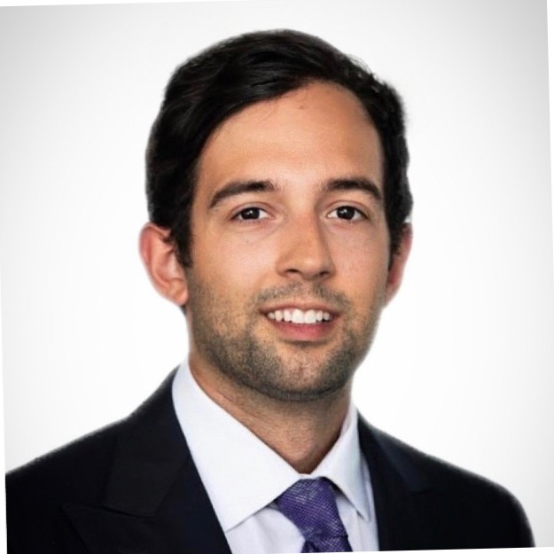
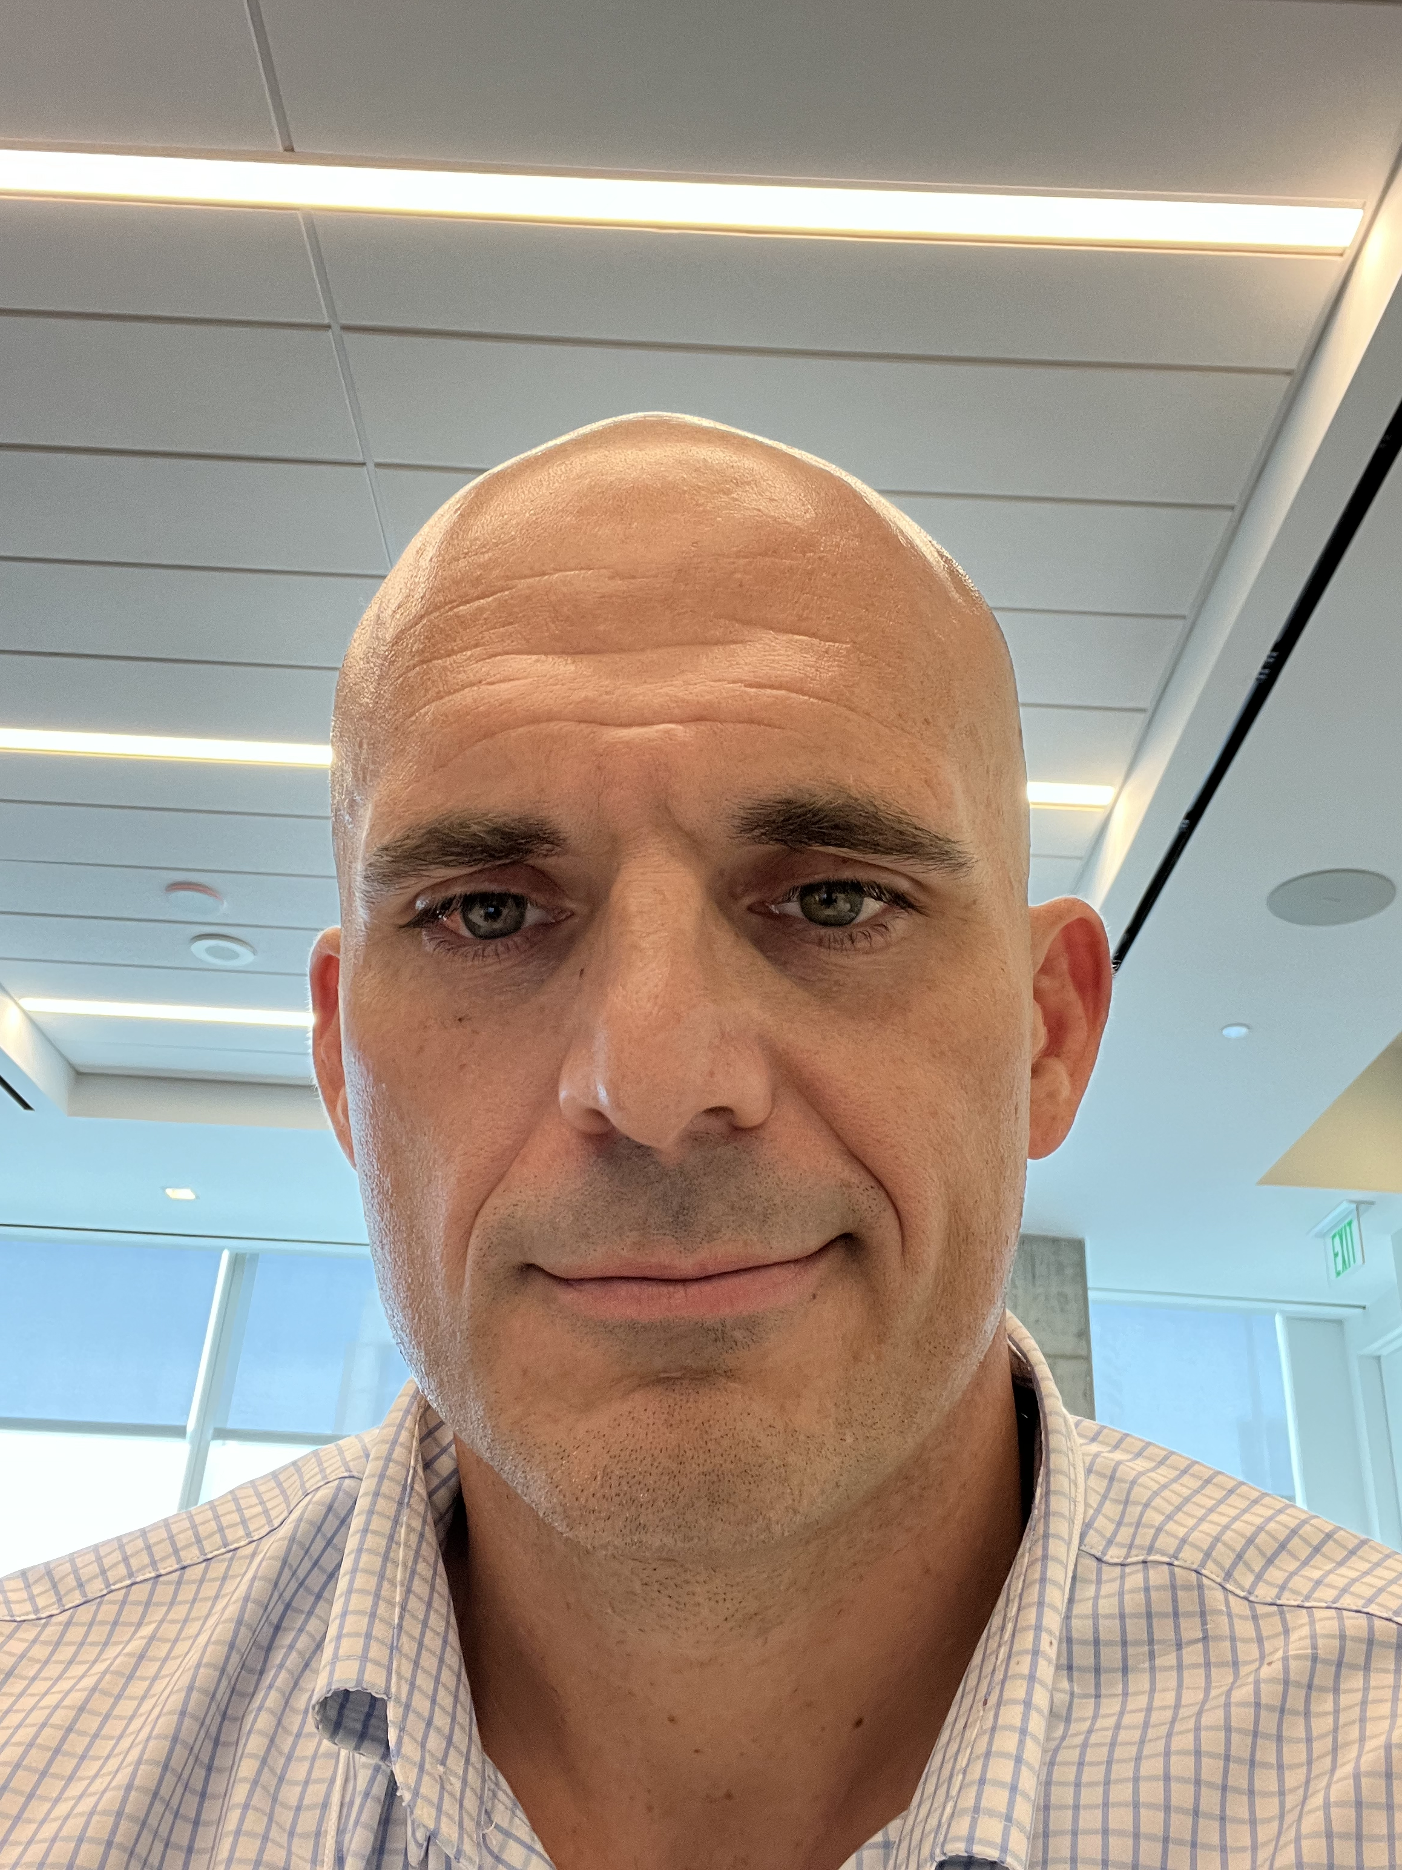
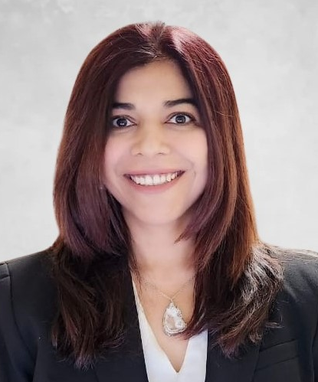
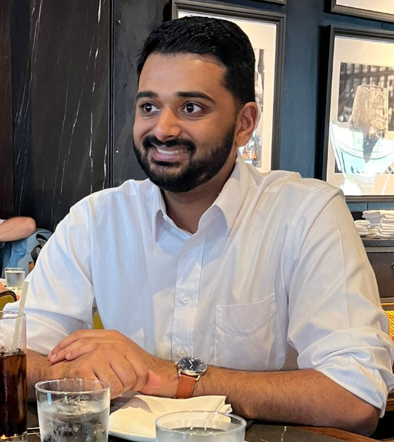
FINANCE & HEALTHCARE
Schuyler Hedberg
Previous Employer: Morgan Stanley Investment Management
Undergraduate: Babson College
Internship: Morgan Stanley Investment Banking
Sector Coverage
Craig Jones
Previous Employer: U.S. Army
Undergraduate: University of the Incarnate Word
Internship: McKinsey & Company
Sara Bhatti
Previous Employer: Innovate Ventures LLC
Undergraduate: National American University
Internship: Amazon
Ryan Ptak
Previous Employer: Accenture – Management Consulting
Undergraduate: University of Michigan
Internship: JPMorgan Private Bank
Vinay Narayanan
Previous Employer: Wells Fargo
Undergraduate: University of California, Berkeley
Internship: Bank of America

Slide 20
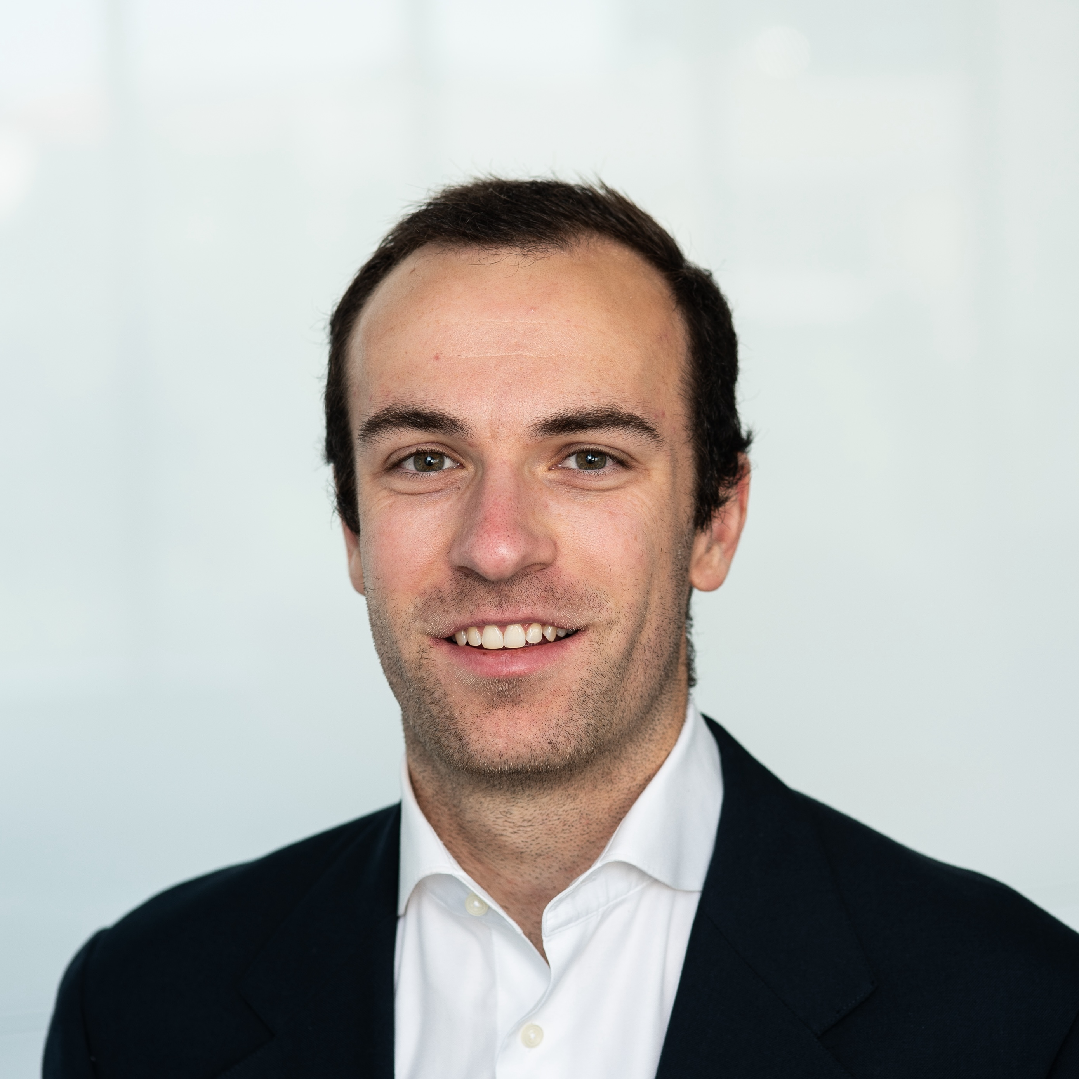
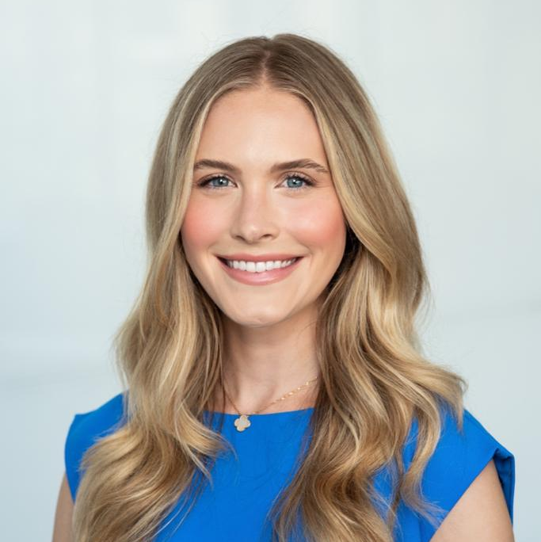
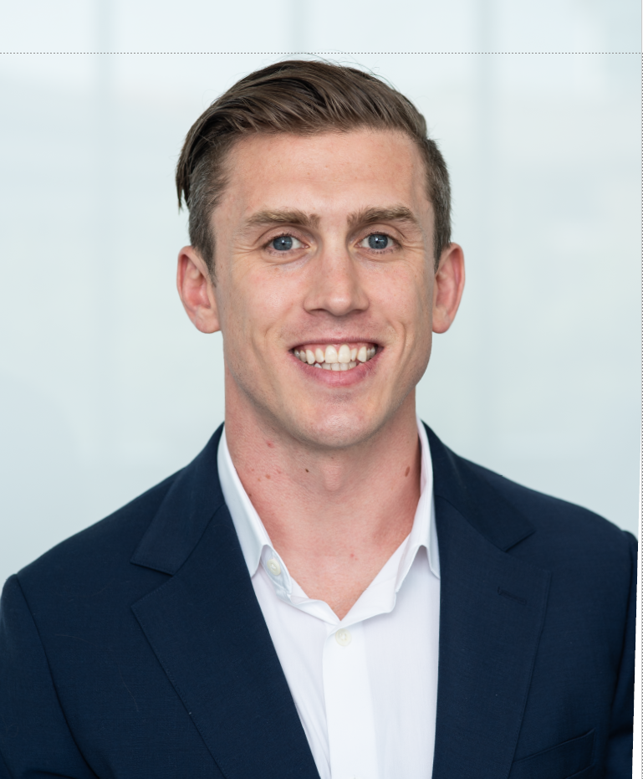
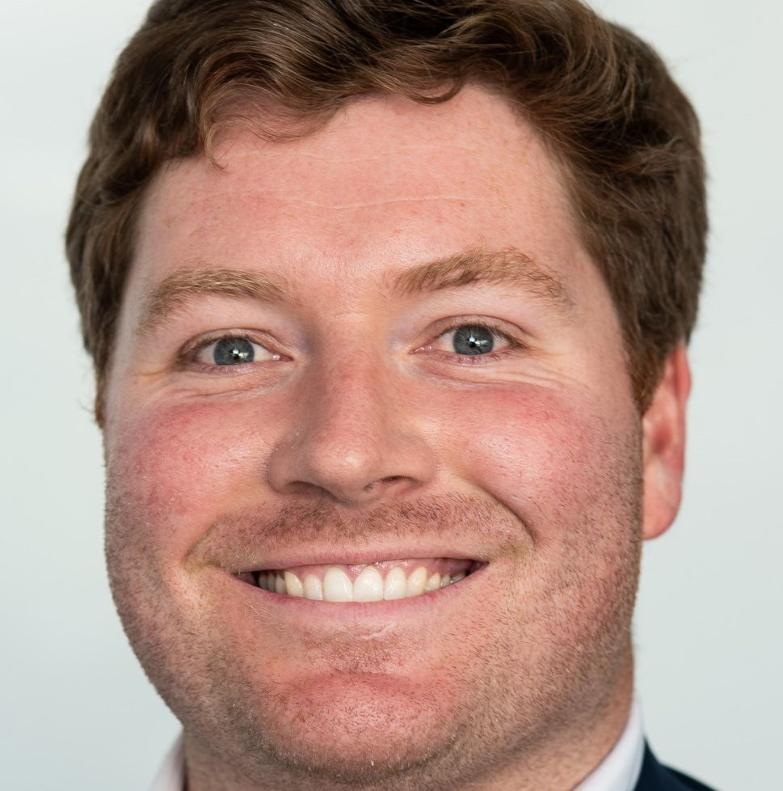
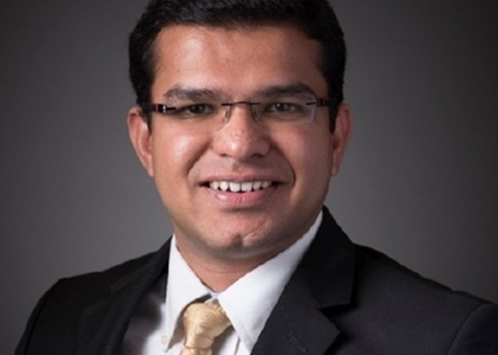
CONSUMER DESCRETIONARY
Consumer Descretionary
Matt Jacobs
Previous Employer: MCJ Management
Undergraduate: Wake Forest University
Internship: First Horizon
Sector Coverage
Madison Regan
Previous Employer: Advanced Micro Devices – Sales Finance
Undergraduate: University of Texas at Austin
Internship: Capital Creek Partners
Daniel Shea
Previous Employer: U.S. Army
Undergraduate: The Citadel
Internship: Wells Fargo
Thomas Tatum
Previous Employer: CalSTRS
Undergraduate: Santa Clara University
Internship: Ancient Art
Srinath Narayanan
Previous Employer: Cummins Inc
Undergraduate: Anna University, Pennsylvania State University
Internship: Applied Materials

Slide 21
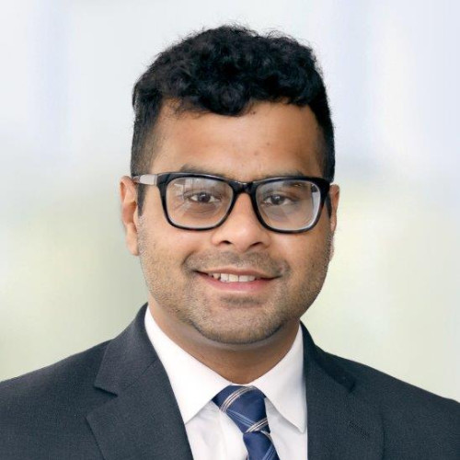
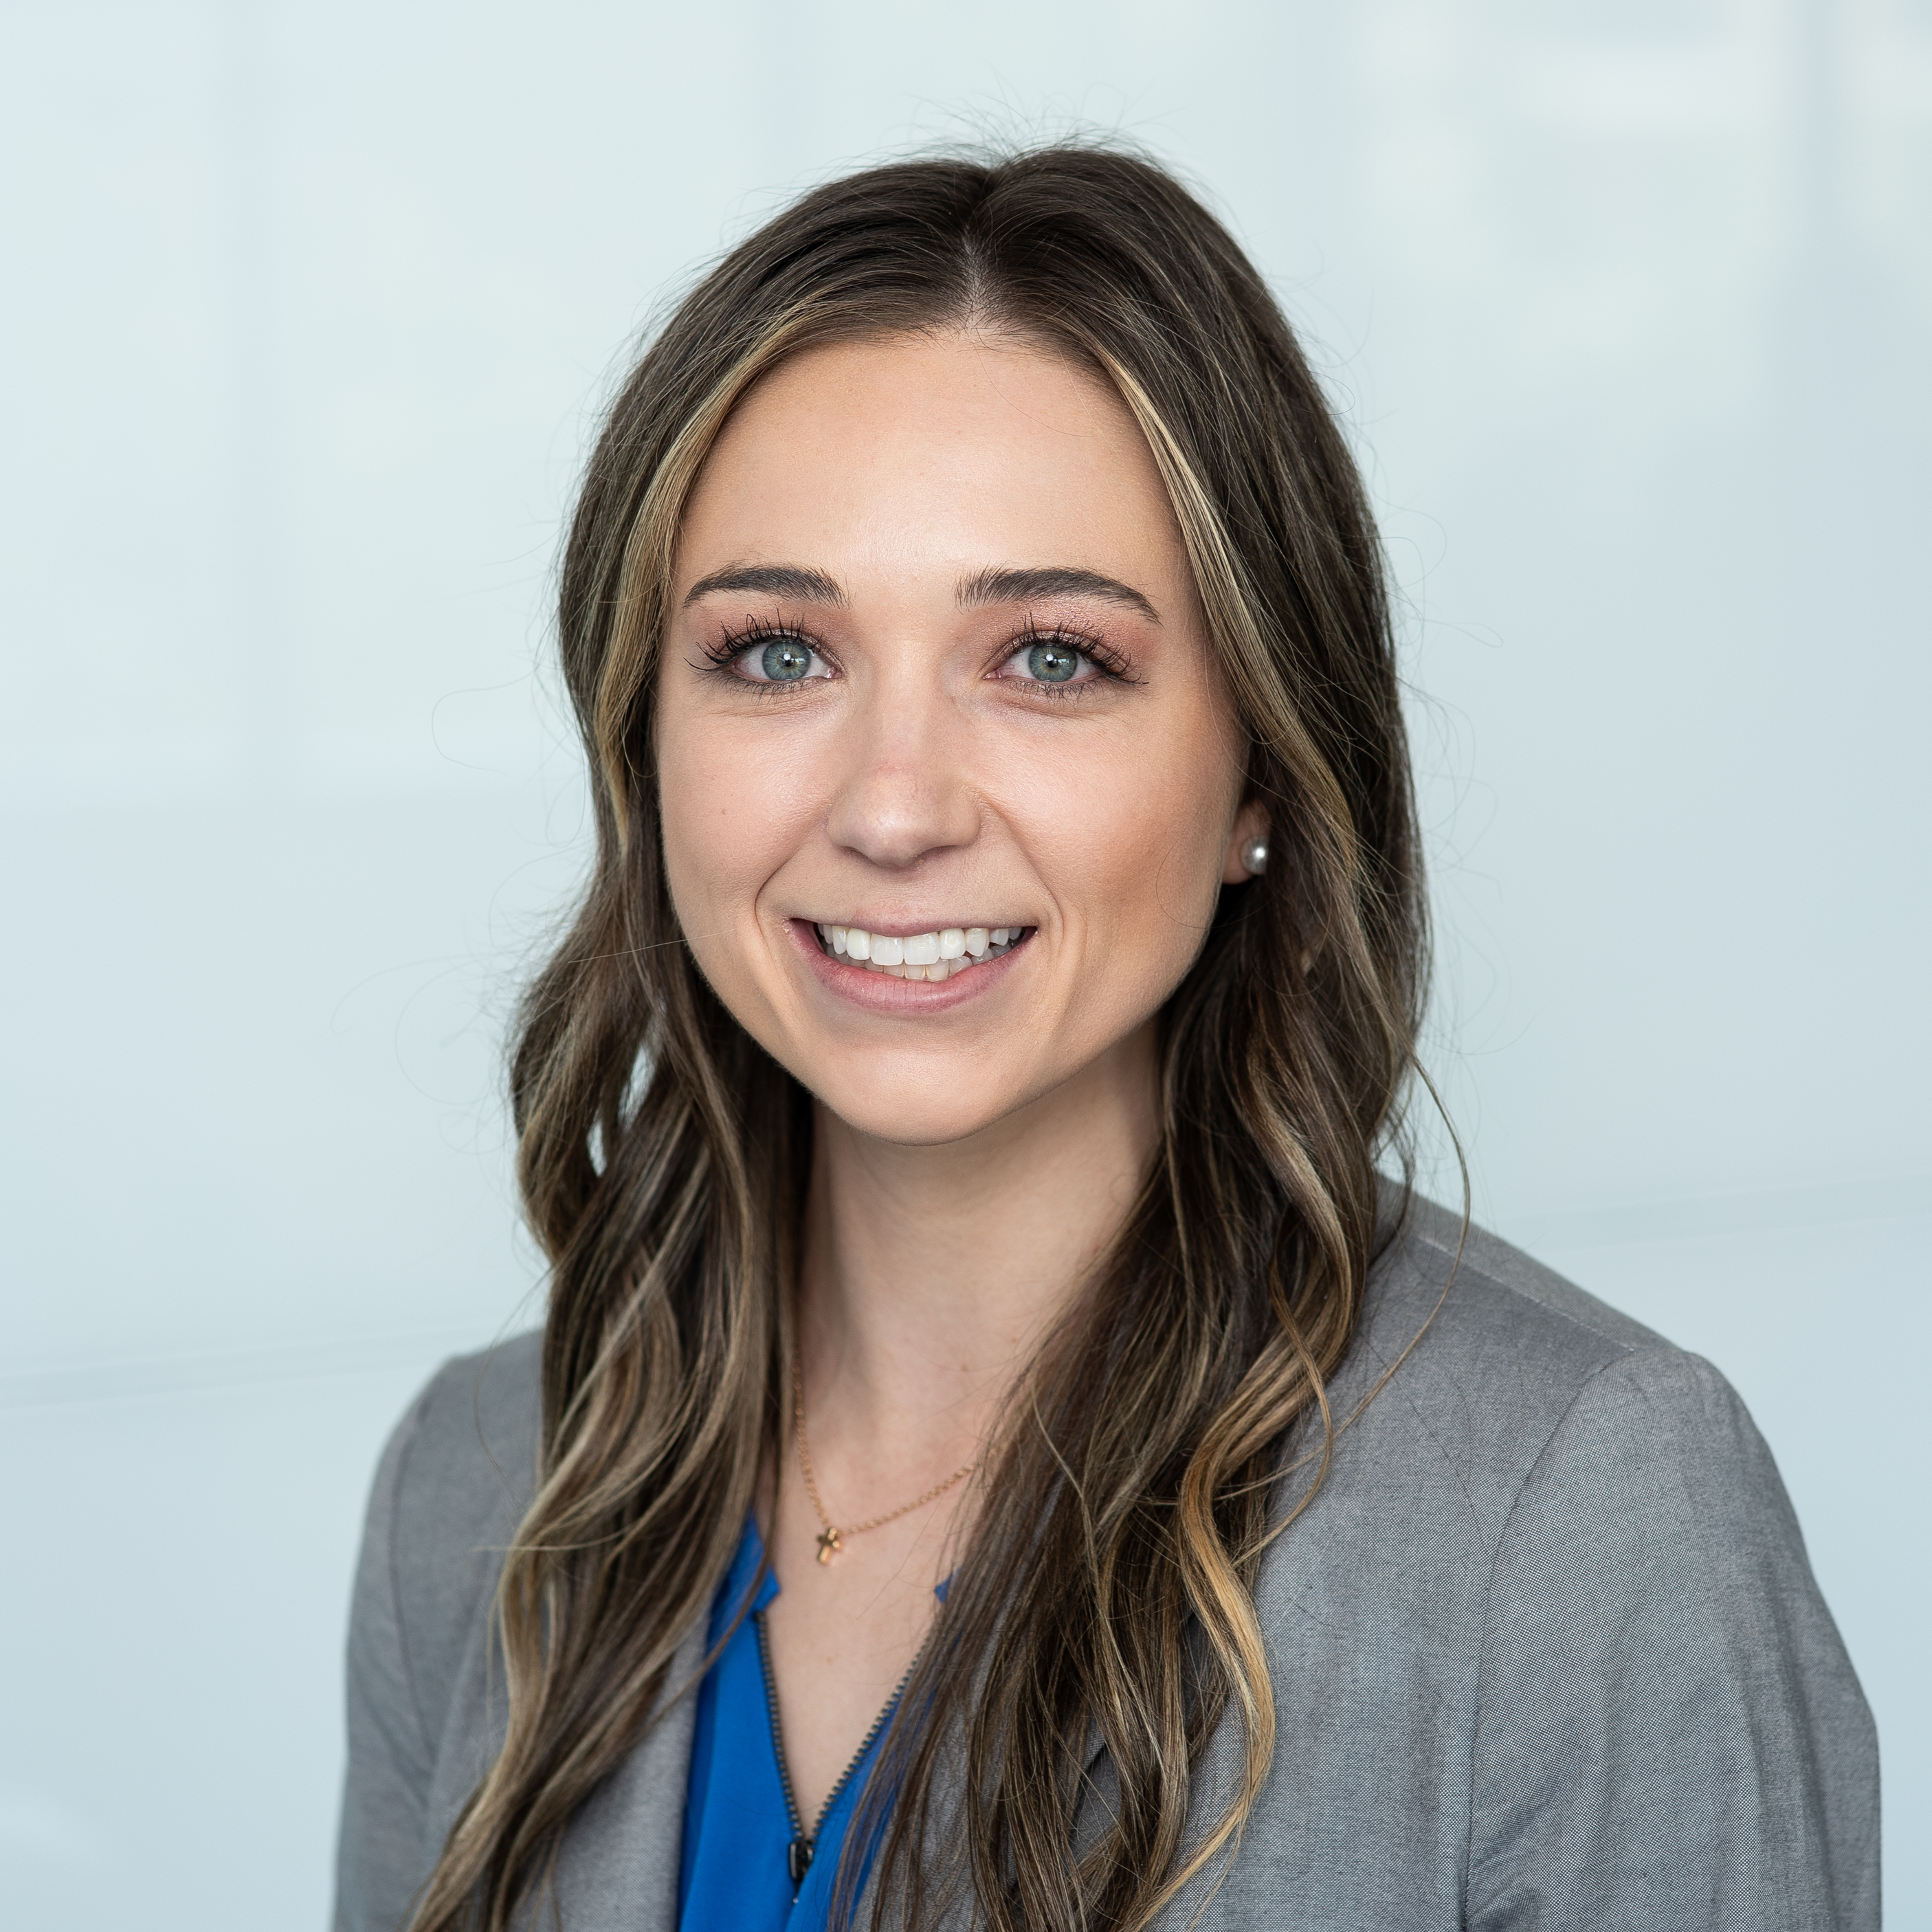
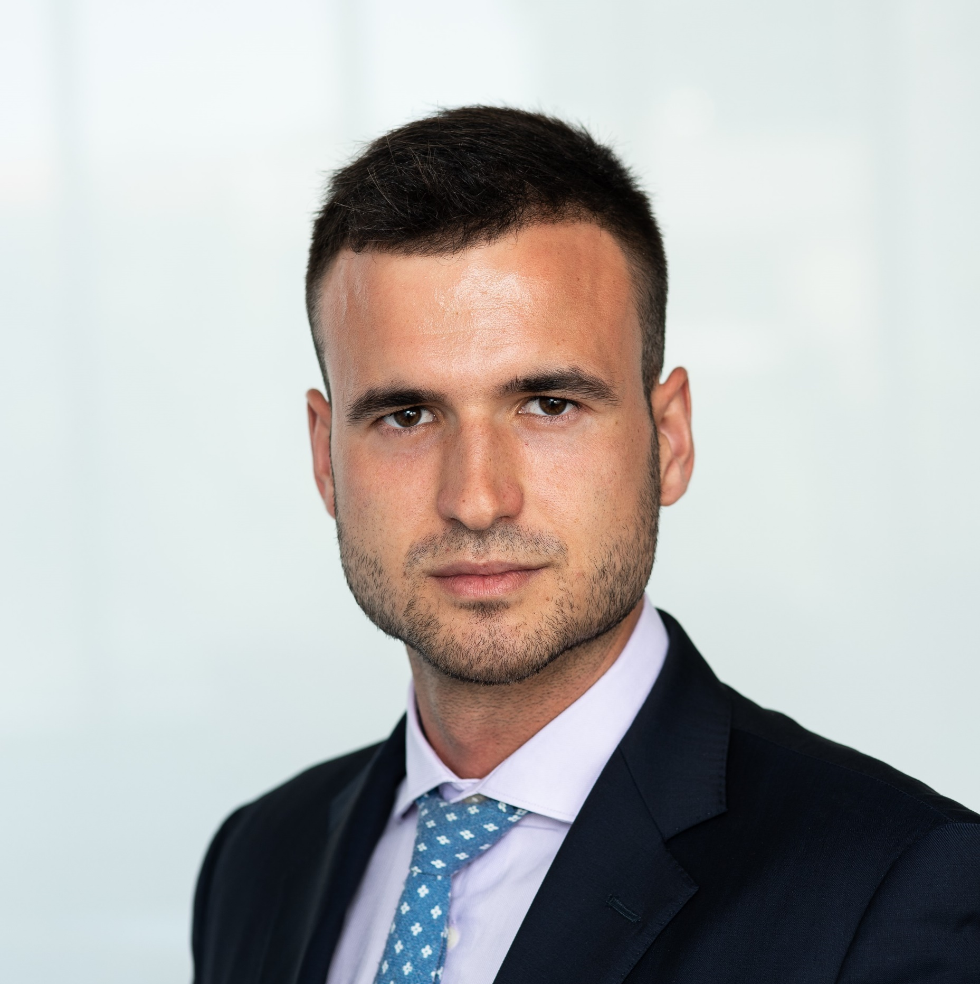
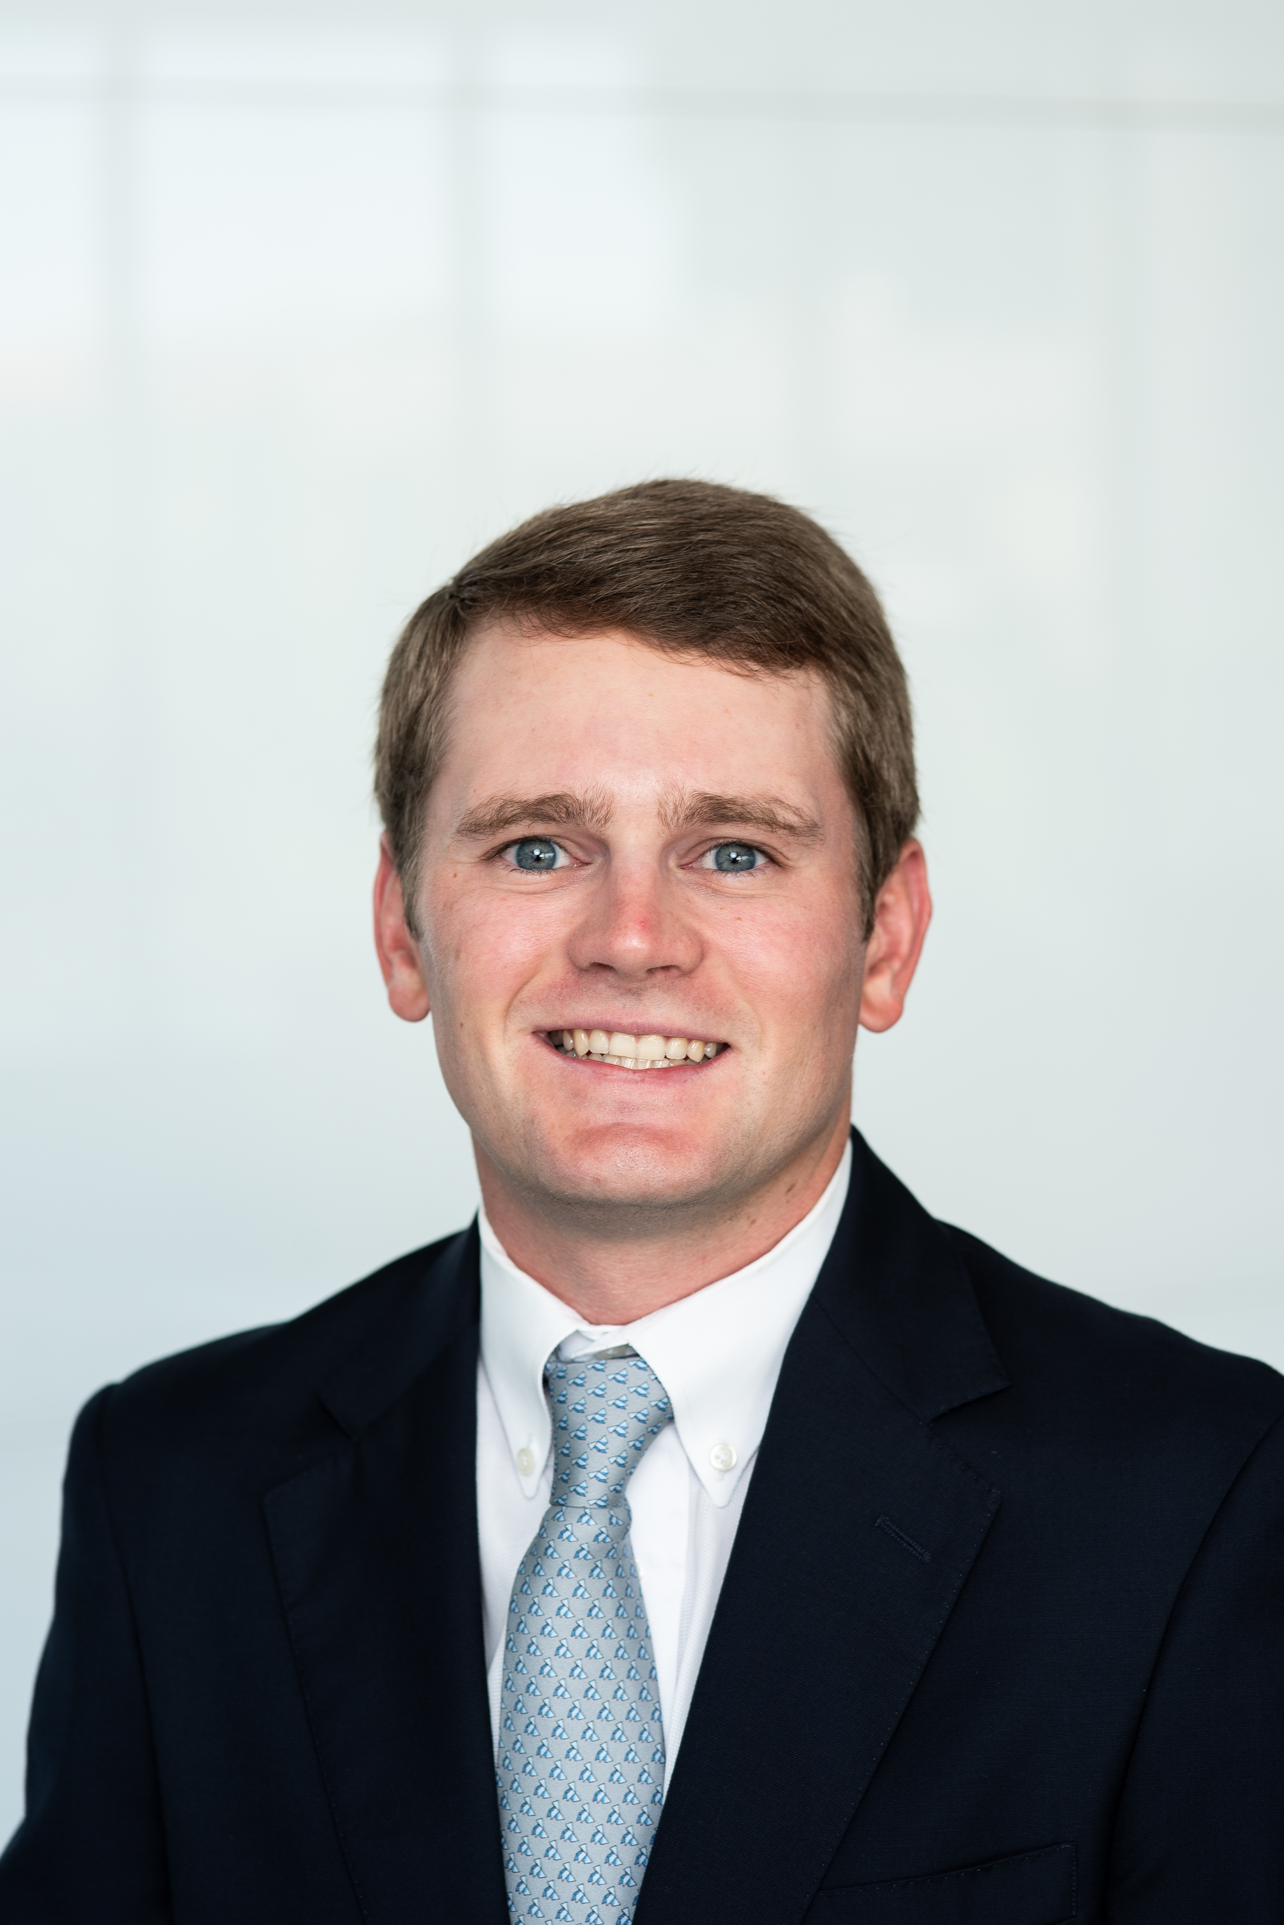
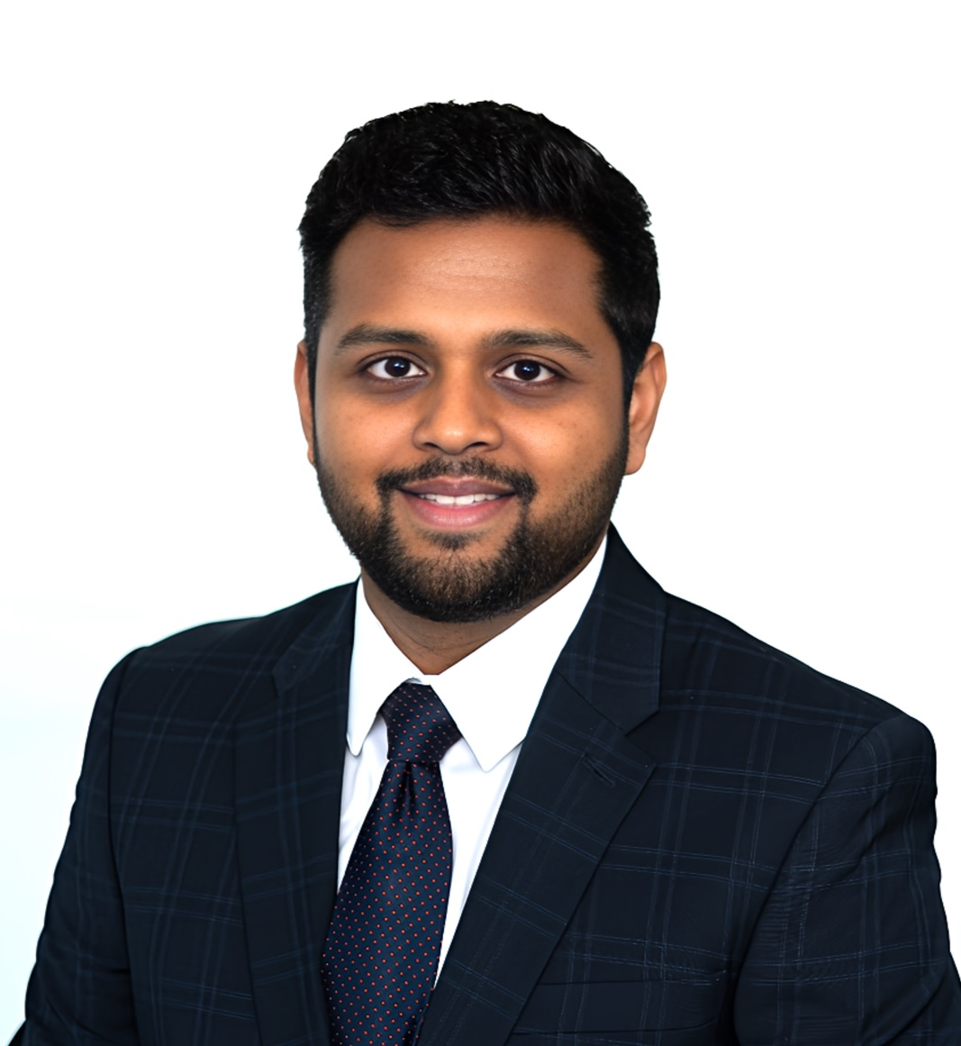
ENERGY
Stephan Thevalingam
Previous Employer: KPMG Consulting
Undergraduate: The University of Texas at Austin
Internship: Target Corporation
Sector Coverage
Blythe Baresh
Previous Employer: Dentsply Sirona
Undergraduate: Clemson University
Internship: Morgan Stanley
Bernat Vilella Gabernet
Previous Employer: European Central Bank
Undergraduate: Universitat Pompeu Fabra (Barcelona)
Internship: Rothschild & Co
Jeff Hildebrand
Previous Employer: Nabors Drilling
Undergraduate: University of Texas at Austin
Internship: ConocoPhillips
Shubham Aggarwal
Previous Employer: S&P Global
Undergraduate: University of Petroleum and Energy Studies, India
Internship: McKinsey & Co.

Slide 22
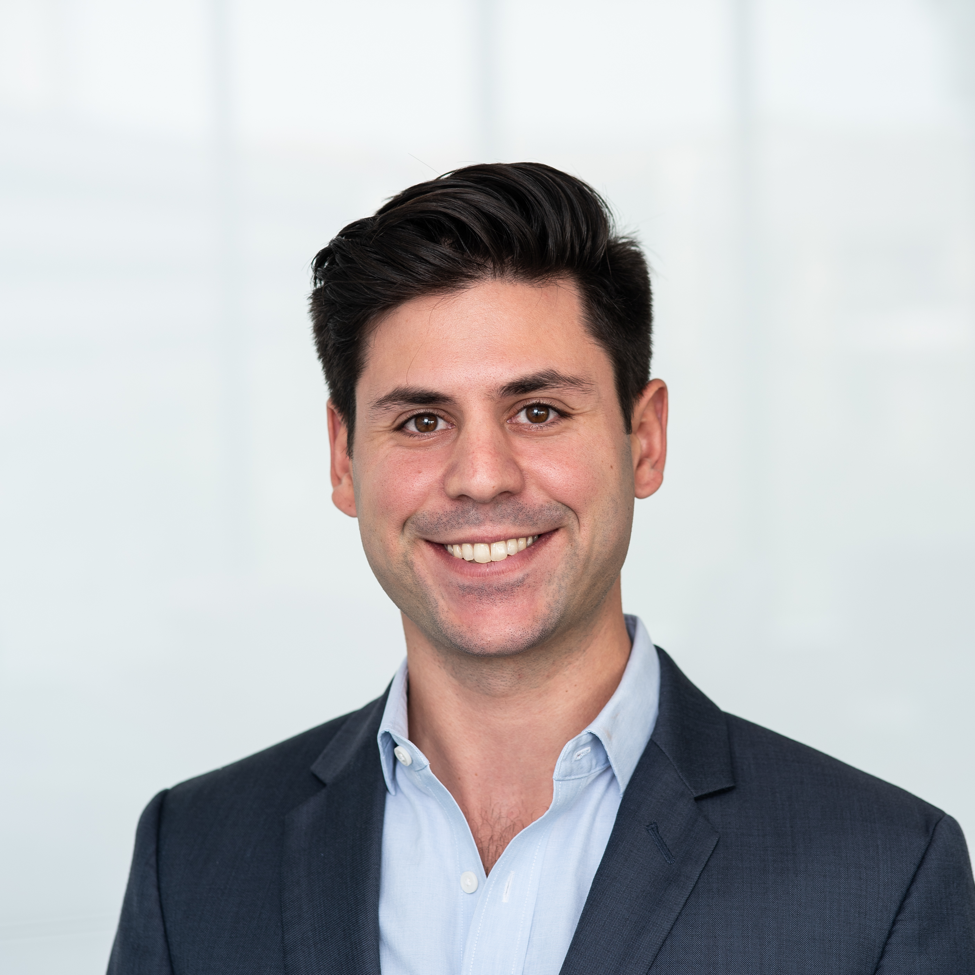
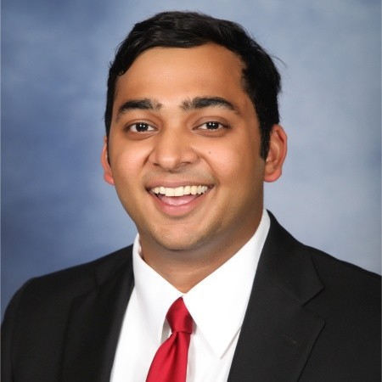
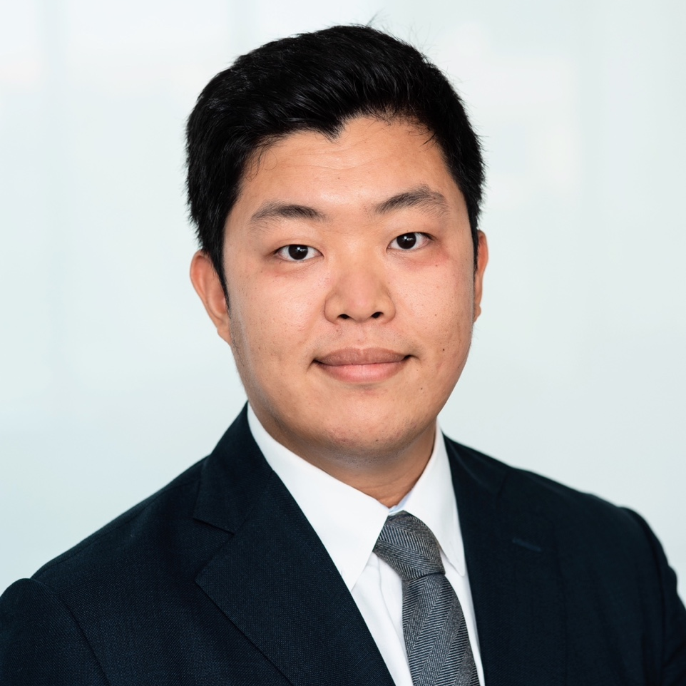
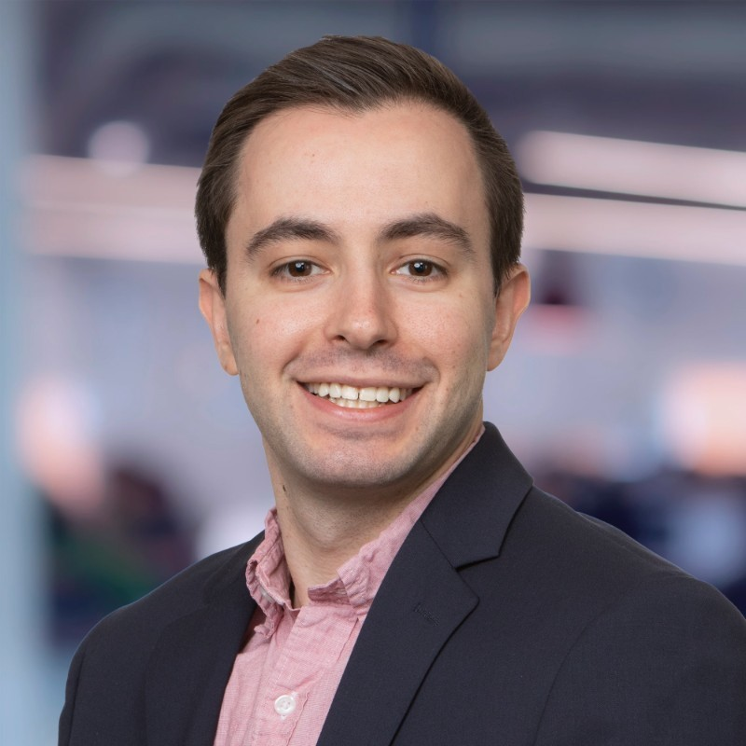
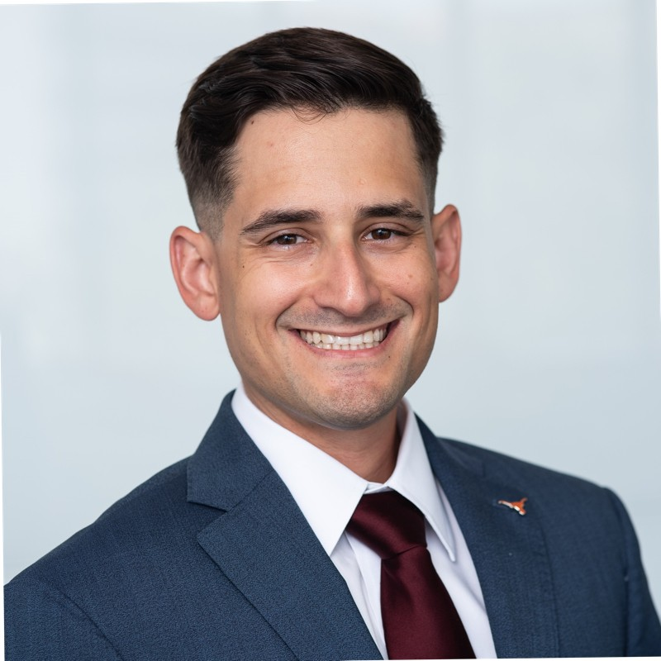
TECHNOLOGY & COMMUNICATIONS
Tom Bachar
Previous Employer: Capital One
Undergraduate: San Diego State University
Internship: Solomon Partners
Sector Coverage
Ravi Narula
Previous Employer: Accenture LLP
Undergraduate: Texas A&M University
Internship: Nomura Greentech
Boseok Kim
Previous Employer: Bank of Korea
Undergraduate: Sungkyunkwan University, South Korea
Internship: Sponsored Student
Ethan Tannenbaum
Previous Employer: Preqin
Undergraduate: University of Michigan
Internship: Truist Securities
Christian Enciso
Previous Employer: Accenture LLP
Undergraduate: Florida State University
Internship: Texas Venture Labs Founder in Residence

Slide 23
Conclusion
Questions?

